Slide 1
Kitsat
Environmental studies course 1

Slide 2
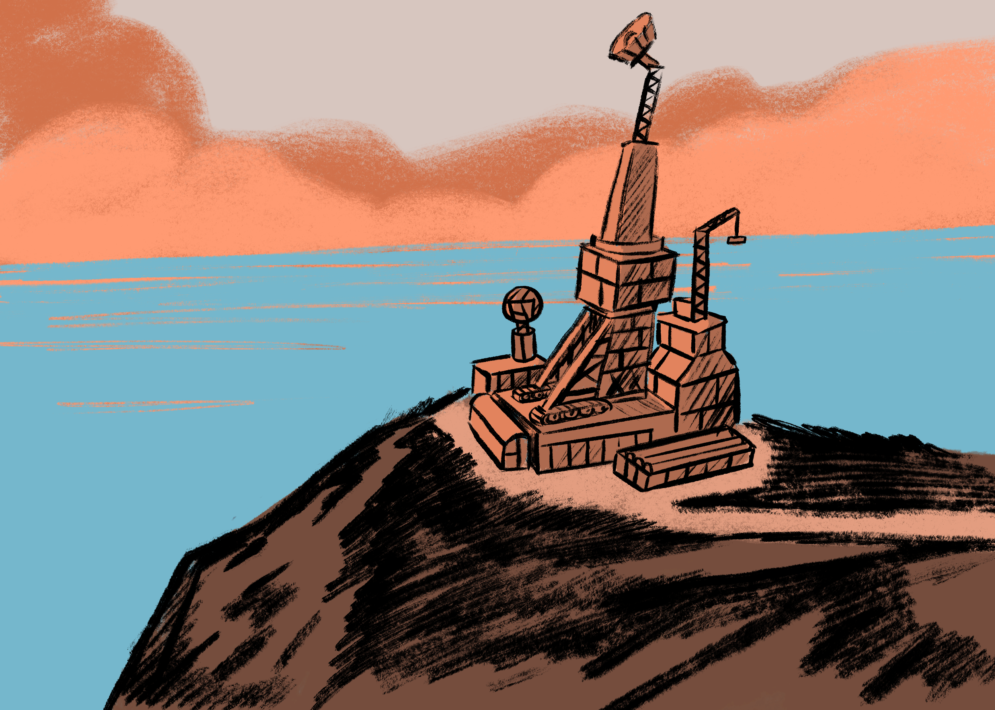
Planet Earth year 2085

Slide 3
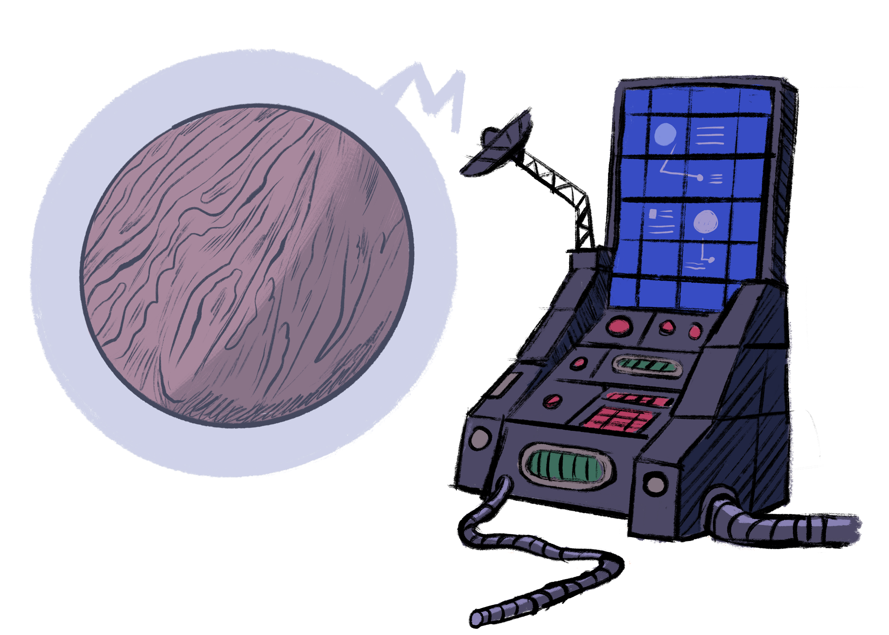
The signal is weak and wobbly but it’s a signal! After years and years of trial and error the success tastes better than ever. The signal OSTRICH (Outer Space Tribunal Research Information and Communications Headquarters) is receiving comes from a planet far far away. The signal is alarming.

Slide 4
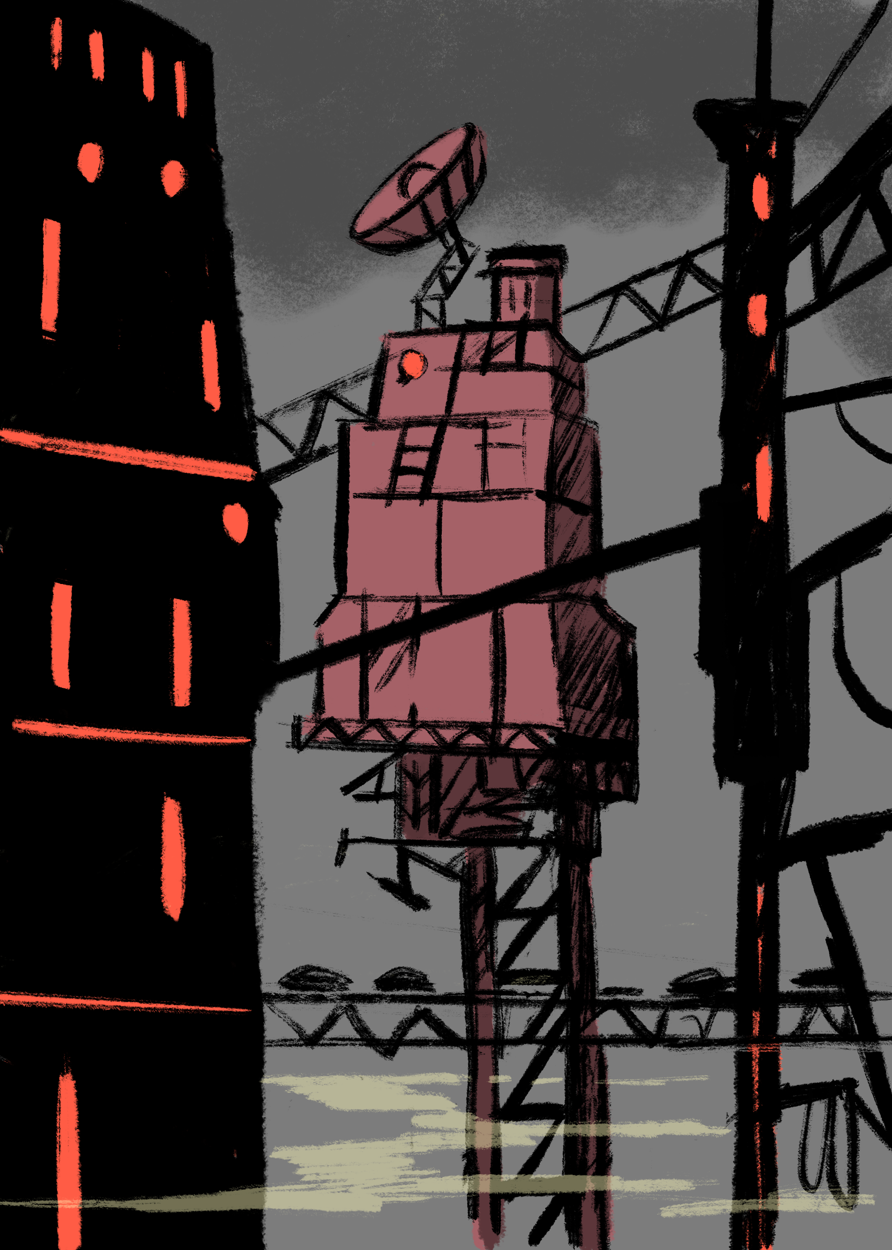
The planet is in deep trouble. The message is loud and clear despite the weak and wobbly transmission. The planet and its inhabitants are in dire need of help. Communications personnel of OSTRICH have written down the following information about the planet:
The climate of the planet is in the brink of turning into uninhabitable
The extreme weather conditions are common and make living on the planet really difficult
The planet is unstable and dangerous
Transportation, traffic and commuting is unsafe

Slide 5
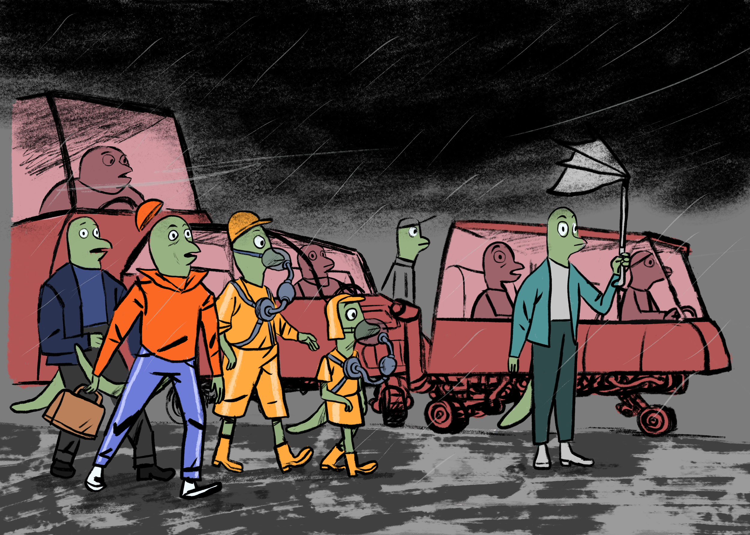
The inhabitants of the planet call themselves lavionians and the planet is called Lavonia. The planet research team of O.S.T.R.I.C.H. have gathered information about the planet and the results are surprising! Lavonia is almost exactly the same as planet Earth and lavonians are almost exact copies of human beings. There are slight differences on the appearance but otherwise they are really close to human beings How’s that for a lucky coincidence!

Slide 6
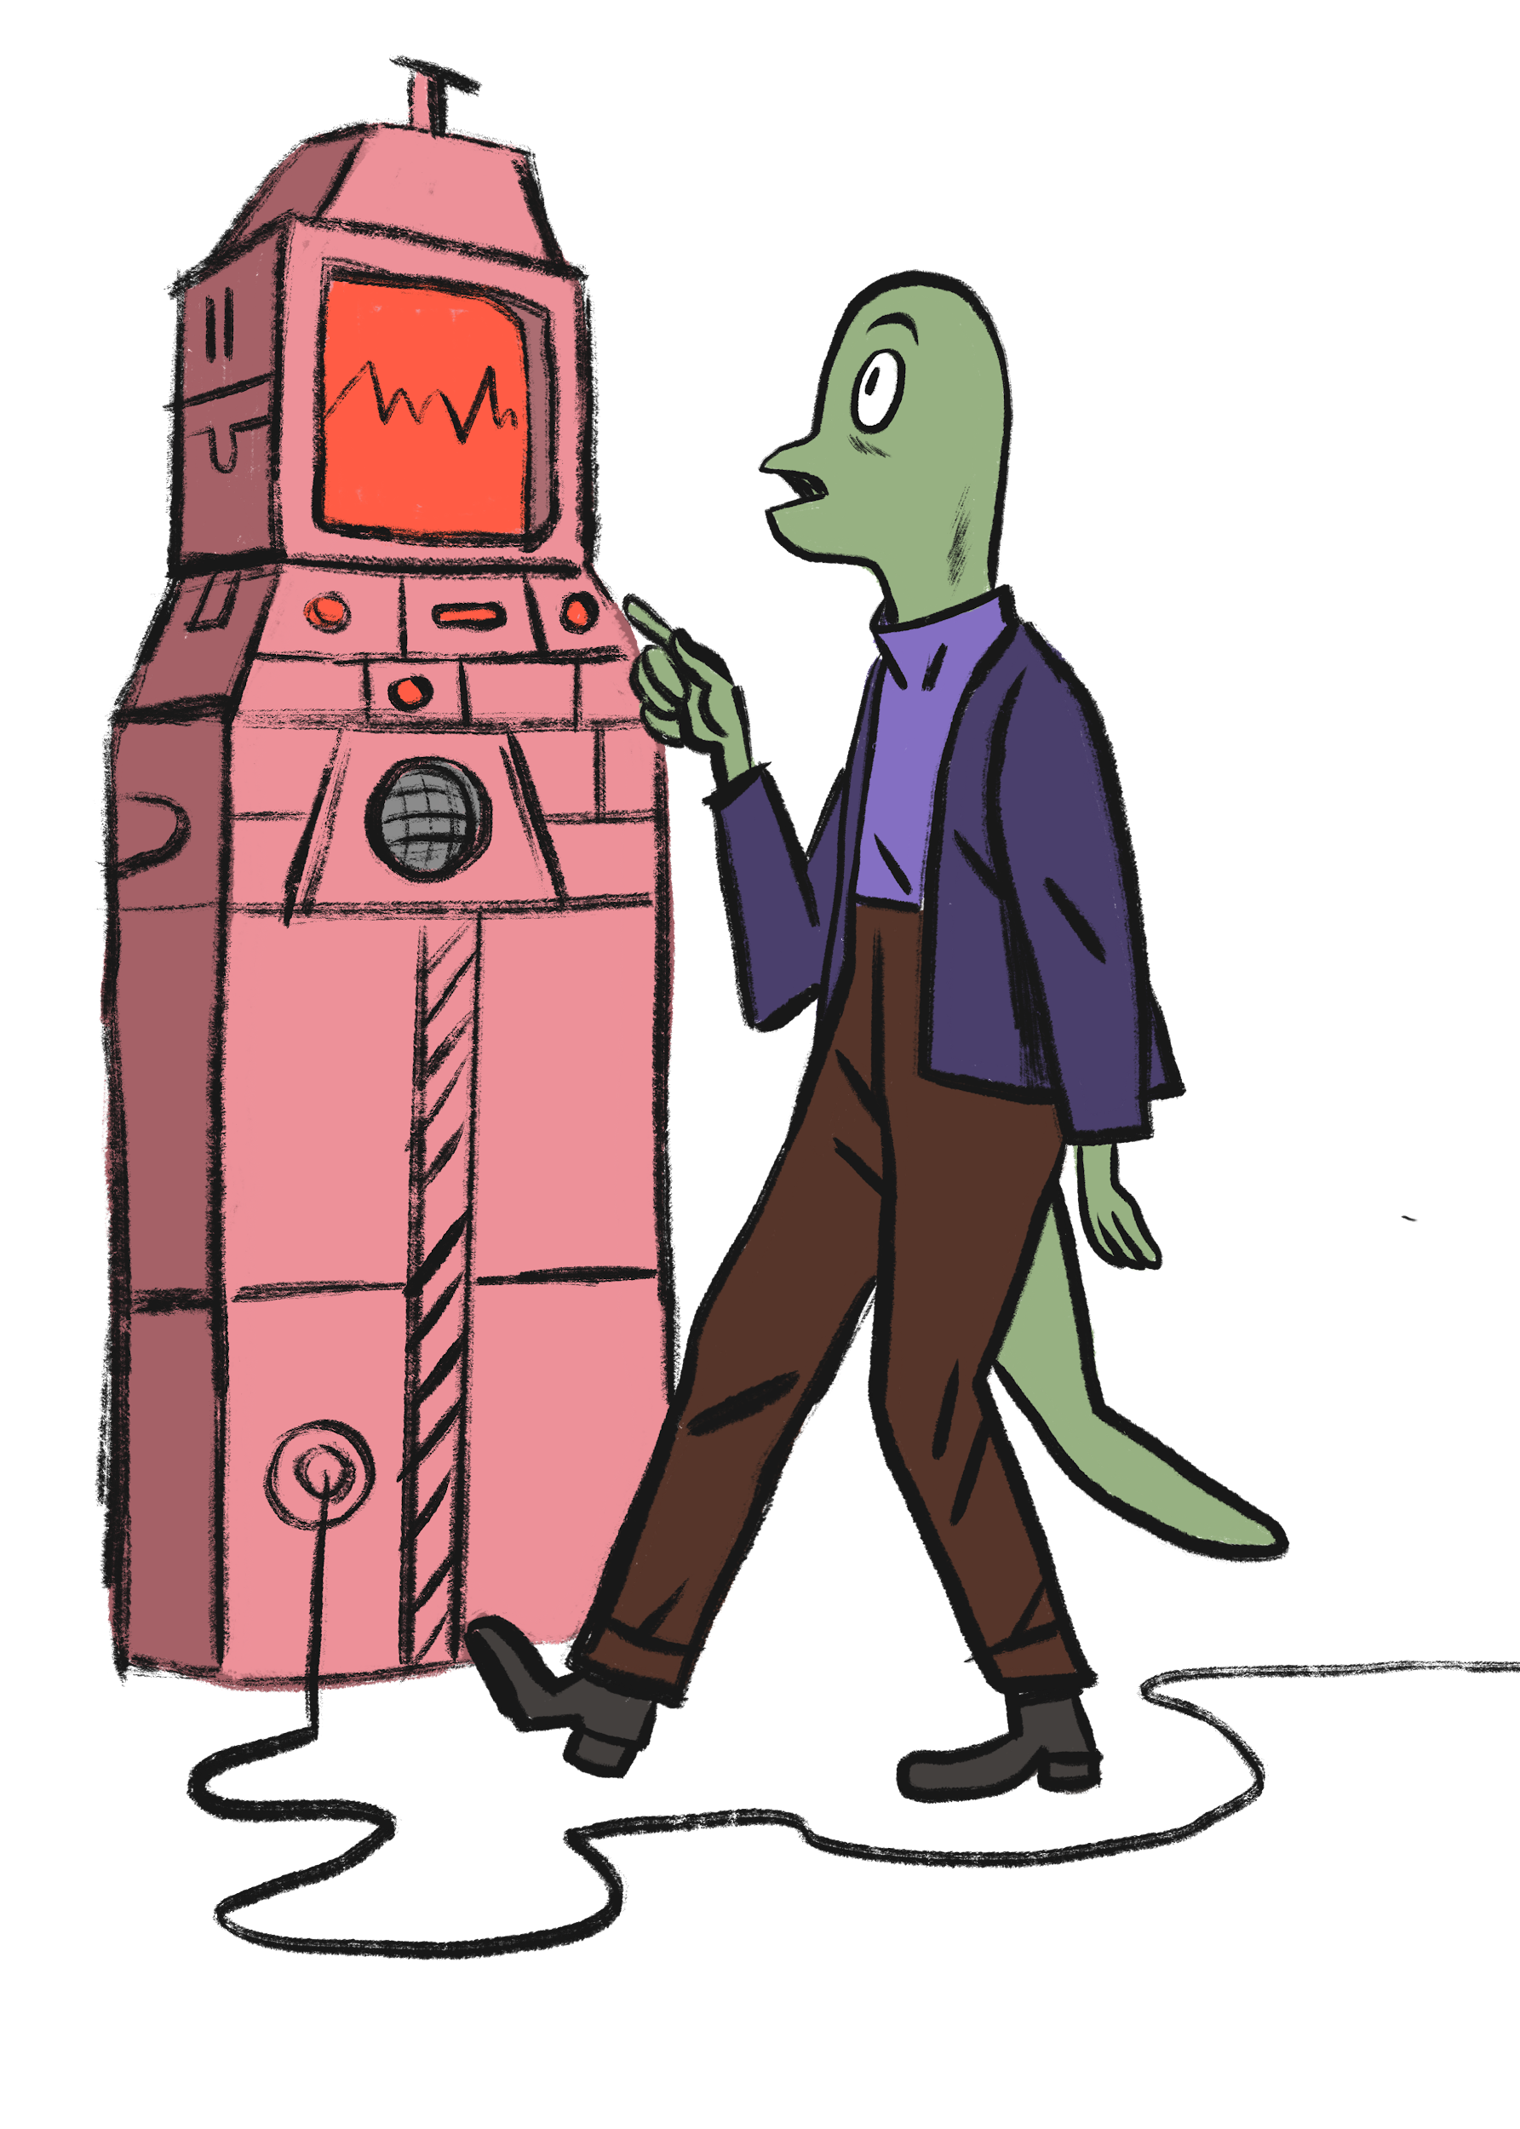
The directors of O.S.T.R.I.C.H. have made the helping operation a top priority. The lavonians have promised to reveal the name of a planet close to Earth as a token of their gratitude. This Earth-like planet would act as a backup home for humanity if Earth would face the same kind of tragedy as Lavonia in some distant future. The lavonians have promised to reveal one piece of the planets name and one piece of space coordinate after each mission. Without the complete name or the coordinates, reaching the planet is impossible.

Slide 7
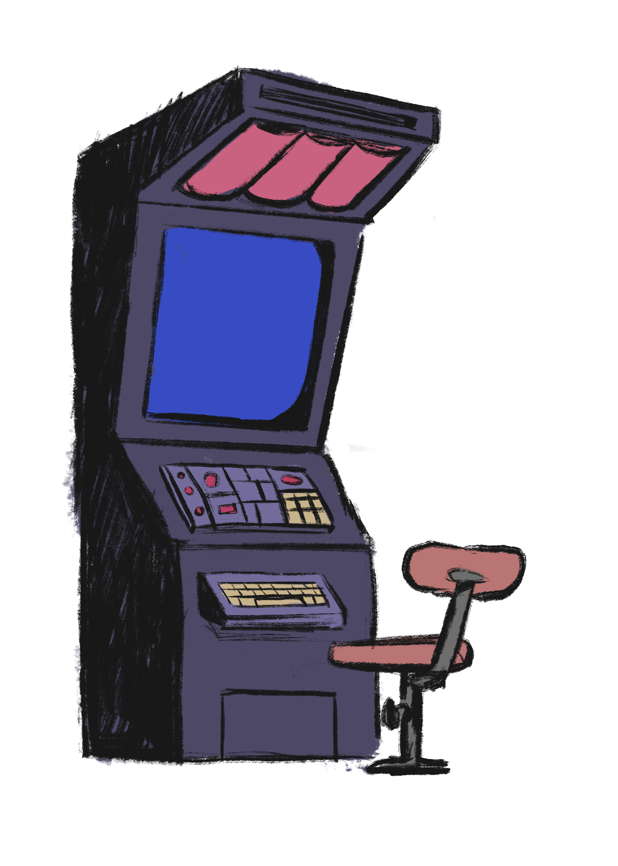
Teams of experts have been gathered and the mission is about to begin. But first you have to login to your new specially made control terminal and get to know your two most important aids on your mission. The Kitsat satellite and the G.A.S.P (Guides and Answers to Save Planets)

Slide 8
ASSIGNMENT 1
The terminal demands you to sign in to it. Signing in unlocks the use of G.A.S.P, communication channel with the lavonians and the Kitsat satellite.
Fill in the character sheet at your terminal.
The Kitsat satellite is quite a new tool for you and your team. The supervisors of O.S.T.R.I.C.H recommend that you get to know it as it is the main tool of helping the lavonians. The console asks you the following questions:
Take out the Kitsat satellite and write down the following details about it
Which materials the satellite and its components consist of?
What is the shape of the satellite?
What are the dimensions of the satellite (height, width and depth)
What is the weight of the satellite?

Slide 9
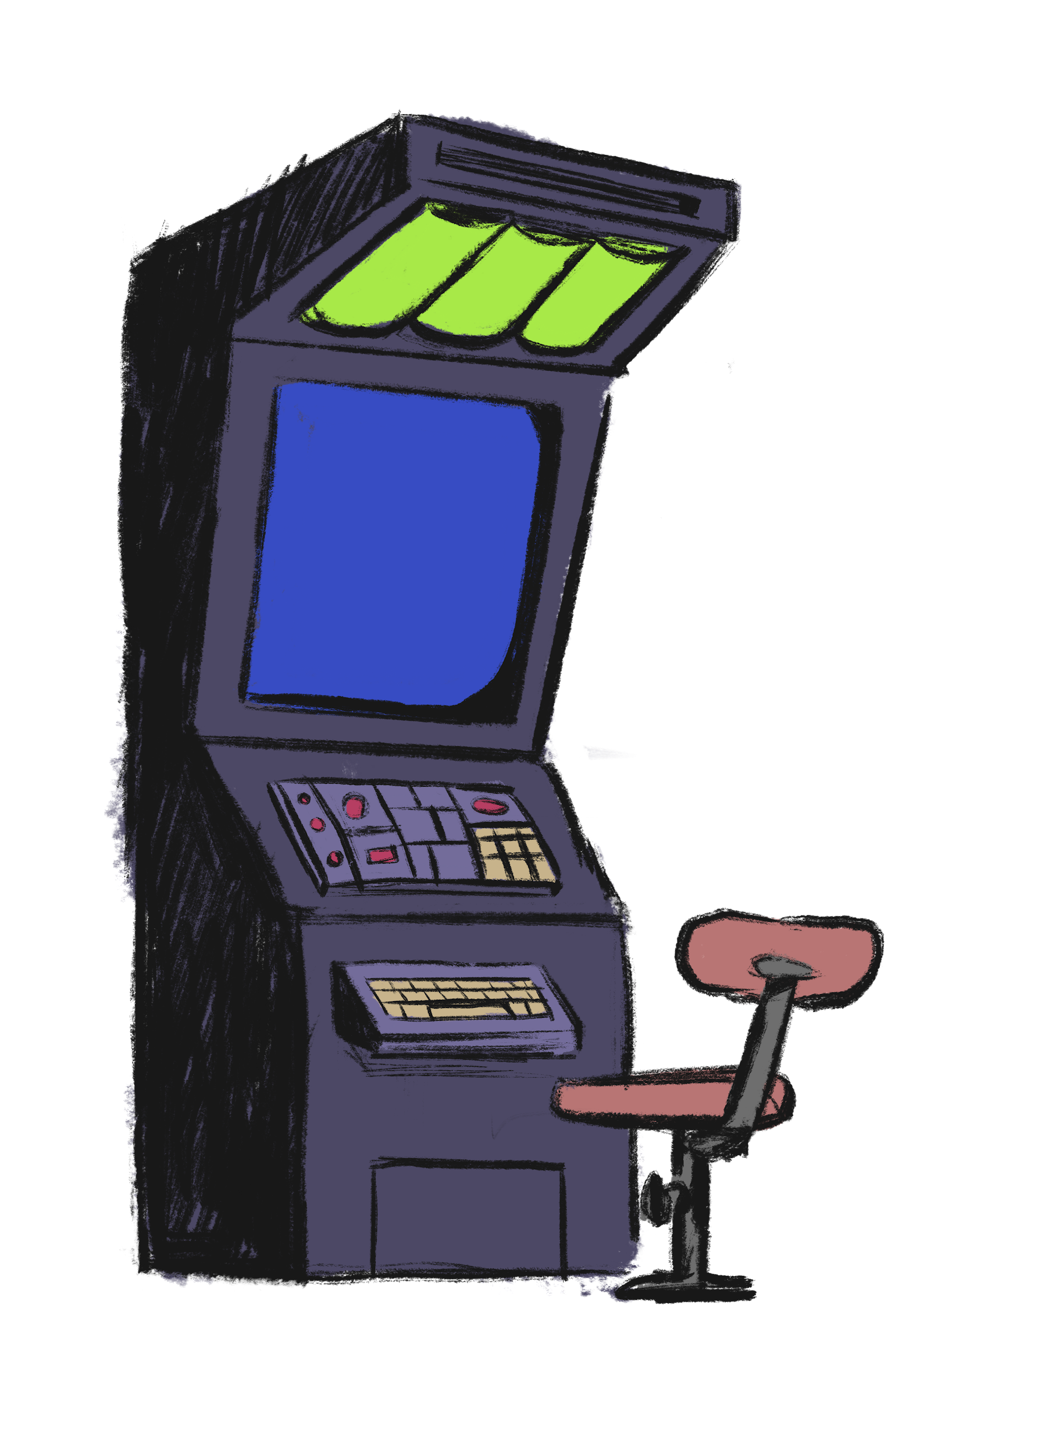
The terminal gives you a green light and you are successfully logged in. In this mission you are using the Kitsat satellite and all of its vast features to solve the questions that the lavonians have sent you to get through their difficult situation.
As a reminder to yourself and your team you examine through the Kitsat satellite’s different features and sensors and list them to your terminal.

Slide 10
The first and on the top of the list of assignments is climate. The climate at Lavonia is on the brink of total failure according to the local scientists. But there is still time to change the course of Lavonia’s climate with the help of your team.
First you have to figure out some basics. And then you might have a hunch that the solution will be closer than you think.

Slide 11
ASSIGNMENT 2
The console informs you to do the following as the first message from the lavonians is waiting for your attention.
-Make a list about the different features, sensors and abilities that the Kitsat satellite has.
-Read through the table of contents from the G.A.S.P. The G.A.S.P. is your bedrock and you will find vast amounts of information in it. But first just go through the table of contents.
- Is there a topic that your team is unfamiliar with?
- Is there a topic that your team is familiar with?
- What is the most interesting topic? Why?

Slide 12
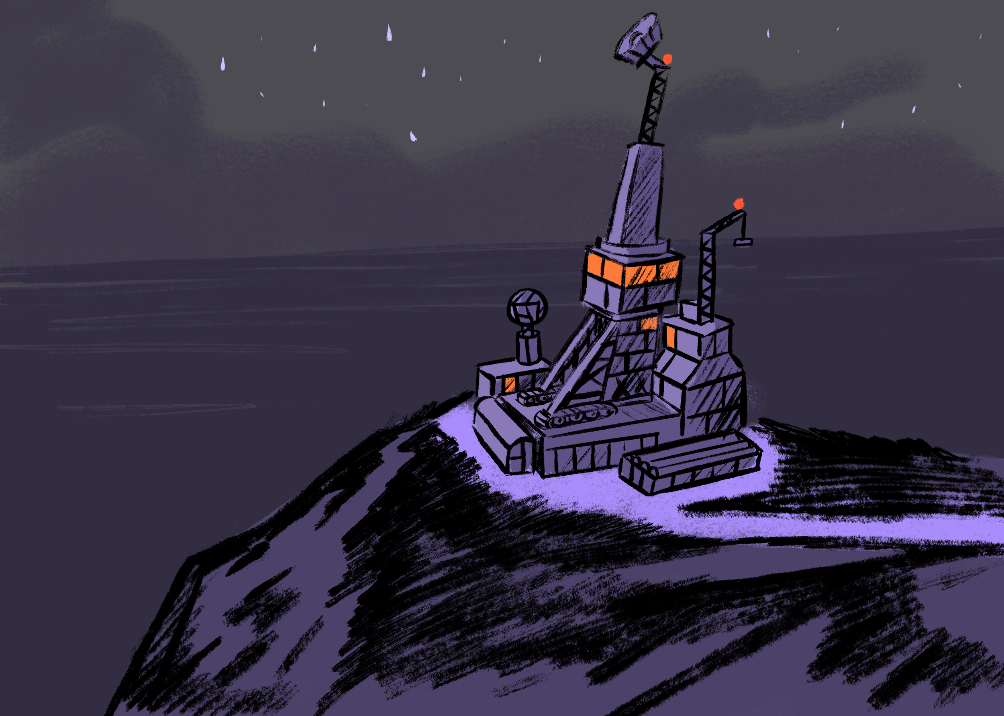
The list is complete and everyone in the team is up to date with the tools and support that you have. It’s time to answer to the first assignment given to the team by the directors of O.S.T.R.I.C.H. The list of assignments is based on the communication between them and the lavonians.

Slide 13
ASSIGNMENT 3:
Explain briefly what climate change means and why it is happening? Remember to check out G.A.S.P. for details and additional information.
Now take the Kitsat satellite outside and have its camera ready. Turn on the camera's IR (infrared) filter. Also make sure that you have the ground station and computer ready.. Also be sure that the satellite and the computer are connected.
Take the satellite outside and take photos of different plants or trees. What do you see? How do the plants and trees look through the IR filter? What may cause them to look like that? How green plants produce energy and in what they use it for? What is the outcome of the energy producing process?

Slide 14

Hooray! The answer to Lavonia’s climate crisis has been in front of your eyes all the time! They have to plant more trees and plants on their planet. That’s it! These green and gorgeous beings will help the lavonians with their climate problem.

Slide 15
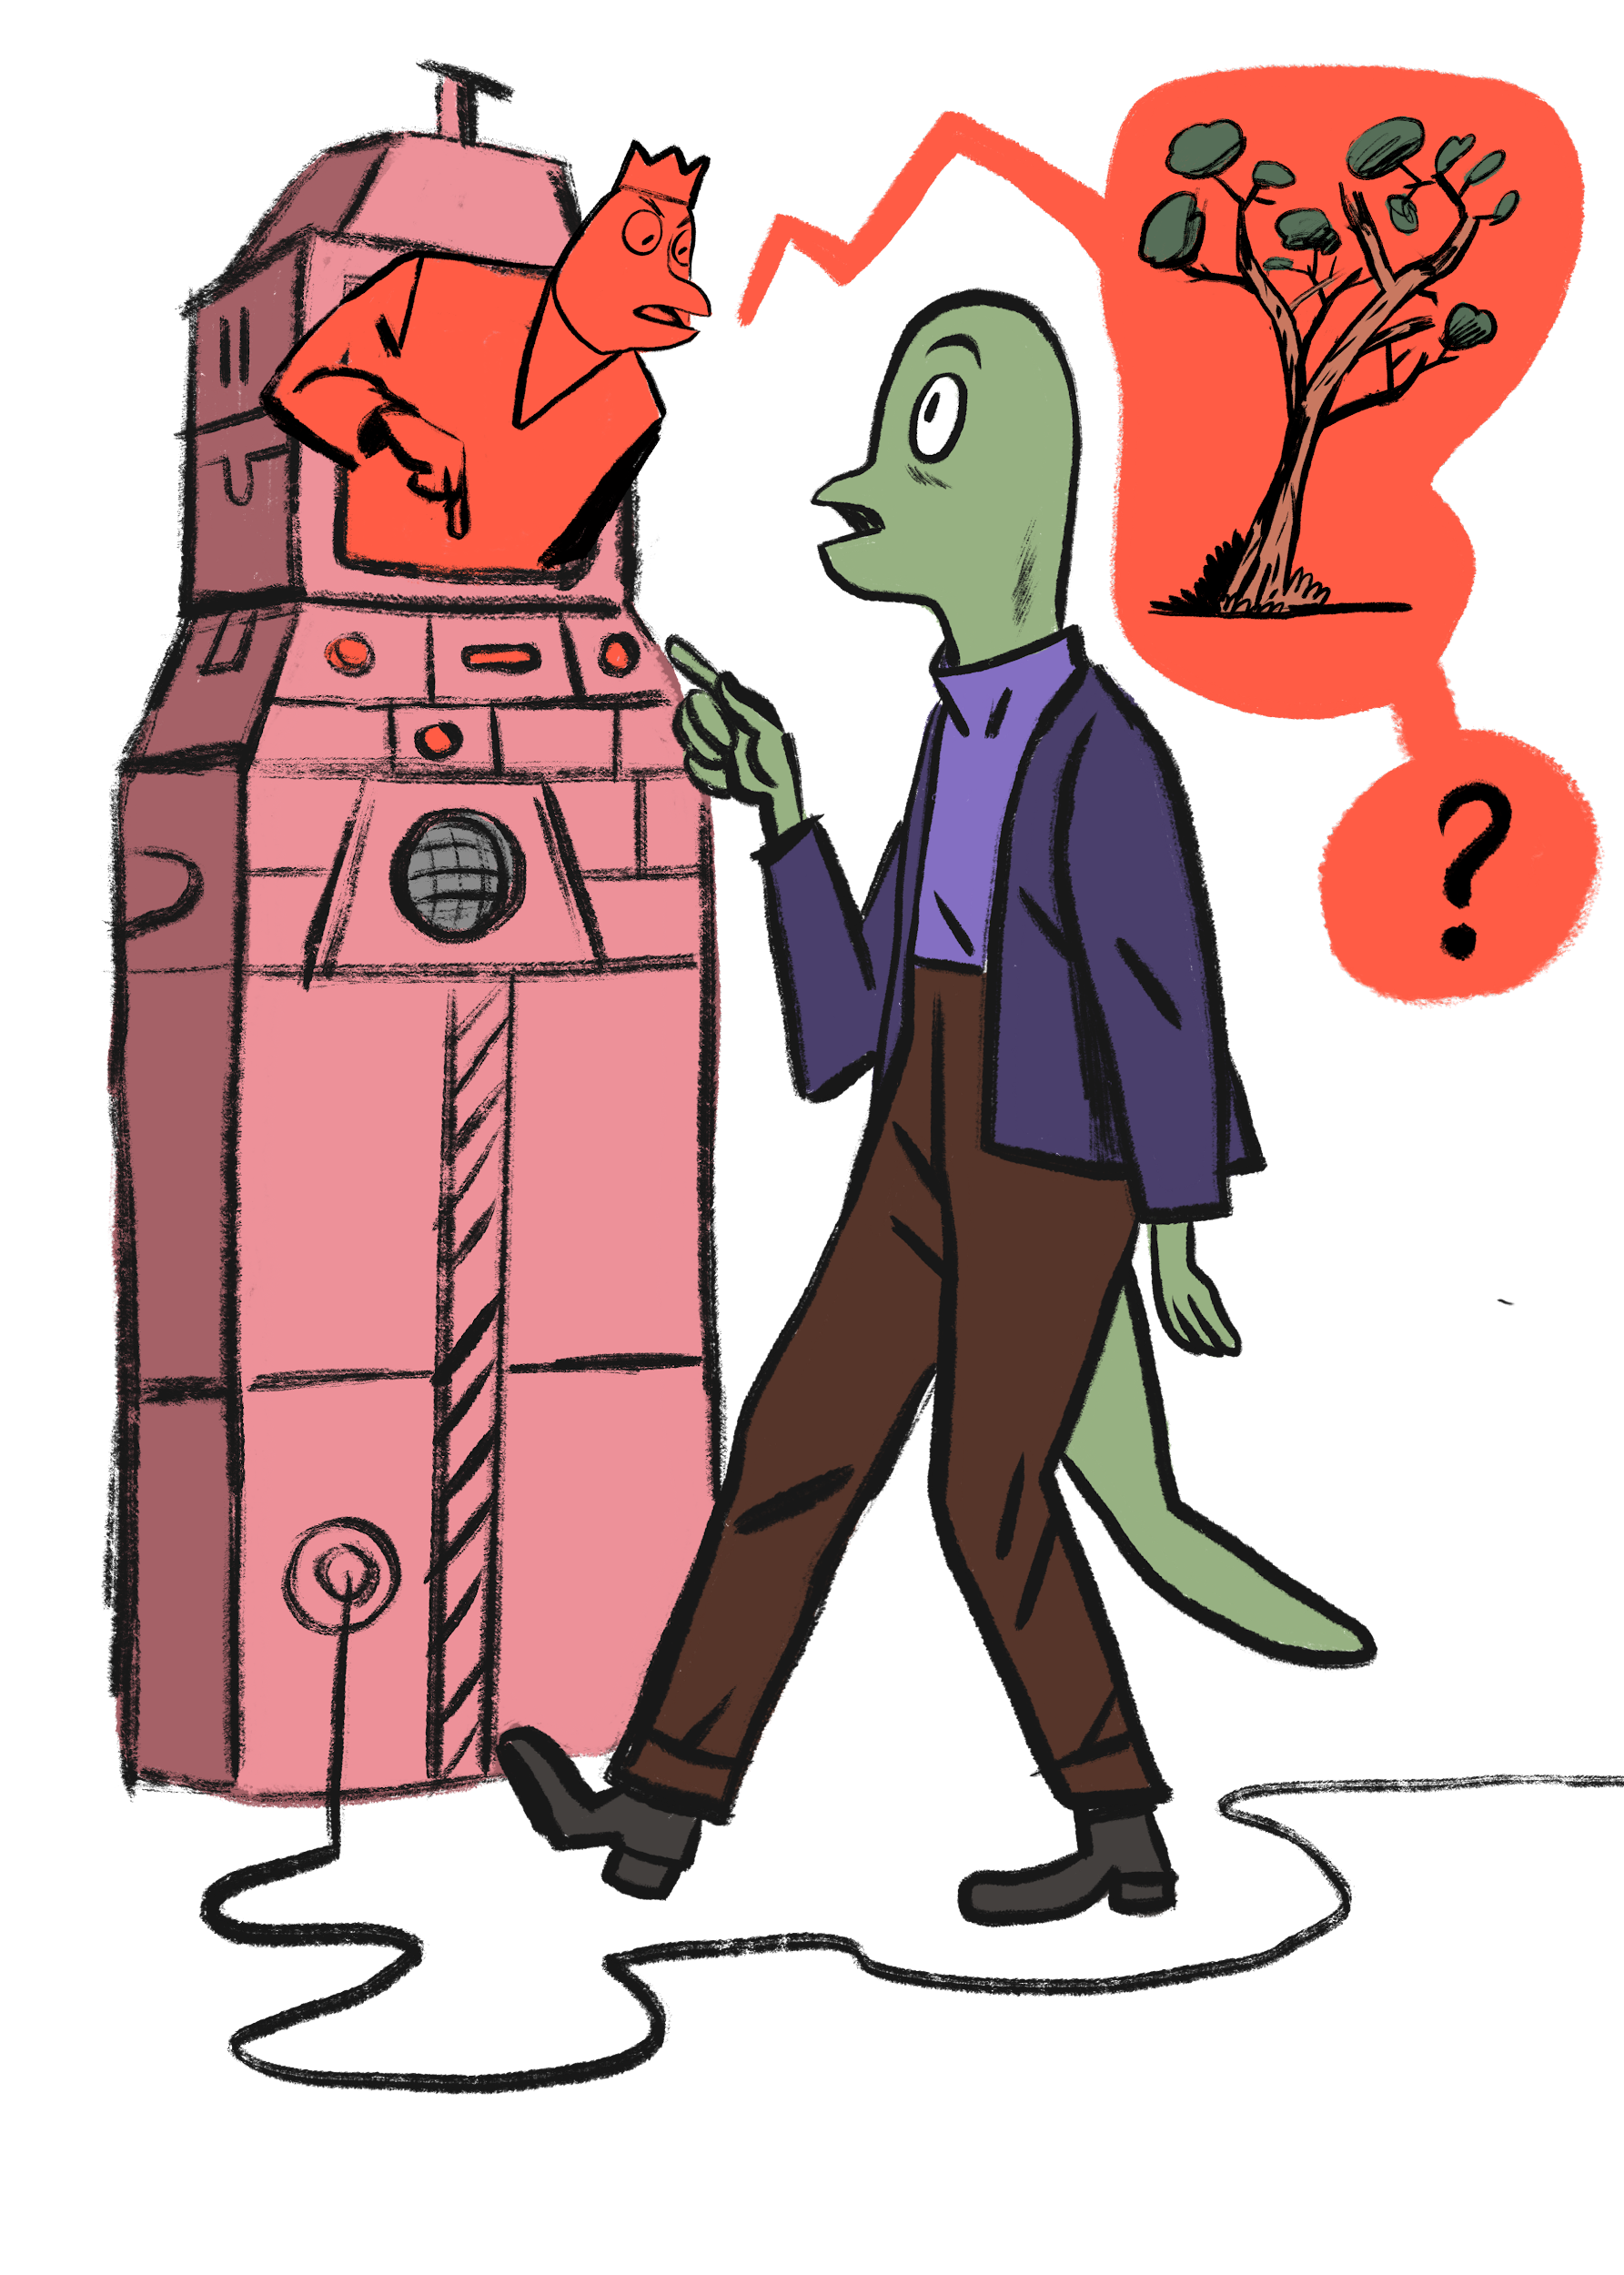
You rush to the communication station and message the lavonians. The message reaches the far away planet in seconds. But the lavonians are confused. Their leaders can’t understand why planting trees and plants would help them. They are not buying your solution and are really sceptical about it. They have used almost all of the planet’s green plants to produce energy and to build cities and see them just as a resource of energy.
Oh no! Back to the drawing board. You have to convince the lavonian leaders that planting trees and plants would be an excellent way to recover their climate.

Slide 16
ASSIGNMENT 4:
Search through your G.A.S.P. and read through the section considering plants and climate.
Write a new message to the lavonians and present an example of how and why plants and trees would have a positive impact on Lavonia’s climate.
What other solutions and actions would affect the planet’s environment in a positive way?
How are the satellites on Earth being used to tackle climate change?

Slide 17
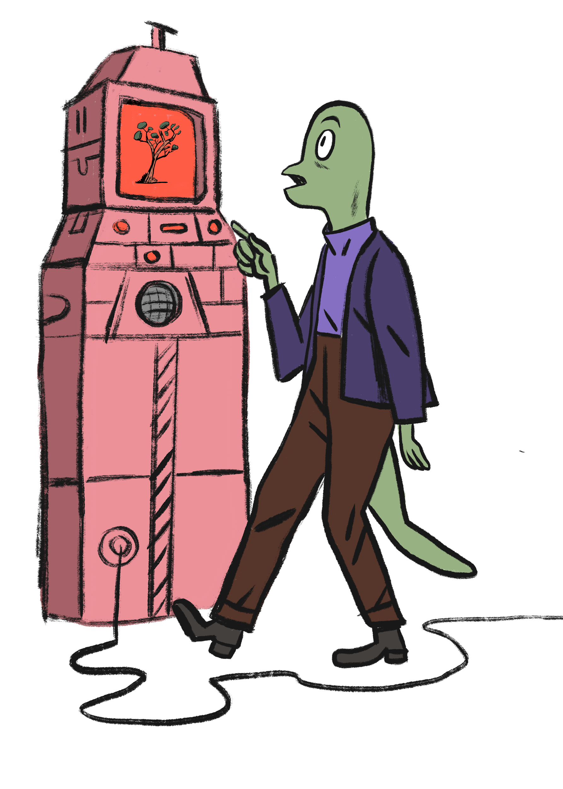
You type in a pretty long and straightforward message to the lavonians and send it. The reply seems to linger on for ages. But after a wait that feels like eternity your console bleeps as you receive a reply. They finally got it! They are planning to start planet -wide planting operation in a few hours. Unbelievable! That is some effective planting! They have also taken into account the other solutions presented in your message.

Slide 18

After a few days the lavonians are reporting that the climate is showing small but convincing signs of improving.
But now they have another problem. It’s the weather. There have been numerous reports on extreme weather conditions around the planet.
The lavonians don’t know how to foresee weather conditions or how to react to them accordingly. They are in desperate need of help. The planting operation is also in danger because of these harsh weather conditions.

Slide 19
ASSIGNMENT 5:
Browse through the G.A.S.P. and look for information about weather conditions. Tell the lavonians the answers to the questions below:
What is the difference between climate and weather?
Which different factors affect the weather conditions?
Why do weather conditions differ around the world?
What can you say about the weather just by looking outside the window?

Slide 20
ASSIGNMENT 5:
You also decide to help lavonians about their problems regarding the forecast of weather.
Take out your Kitsat satellite. Make sure that the satellite is connected to the ground station and to a computer. Also make sure that the satellites camera and the thermometer are turned on and working properly.
If it’s raining outside make sure that the satellite is covered.
Put the satellite somewhere above ground level and let it be there for a few minutes. Make sure that you take a few photos with the camera during the visit outside. Try also taking photos with the IR filter on. Now go back inside to analyze the data gathered.
What can be said about the weather based on the data the satellite has collected?
How are satellites used on Earth to forecast and observe weather?
Write an instruction on how to dress up for the weather conditions at the moment.
Remember to check out G.A.S.P for more details and information.

Slide 21
Nicely done! Now the lavonians have a basic understanding about weather. After your report they specify their problem.
They are sending you a few climate diagrams which paint an alarming picture of the weather conditions around the planet.
Lavonians have gathered this data by themselves but they have no clue on how to read and interpret these diagrams. You have a strong feeling that these diagrams play an important role in making the weather conditions of the planet more pleasant and bearable.

Slide 22
ASSIGNMENT 6:
Take a look at the following climate diagrams around different parts of Lavonia. Read through the information about climate diagrams from G.A.S.P. and answer the following questions.
What is a climate diagram?
What parts or areas on planet Earth might have a similar climate diagram than the ones from Lavonia?
What role do satellites play in making climate diagrams? Could the Kitsat satellite be utilized in making climate diagrams? Why or why not?
Come up with a solution to change the weather conditions at different areas of Lavonia presented by the climate diagrams. Could it be a machine of some sort? A new innovation? Some kind of adaptation to the weather conditions? Or something totally different?

Slide 23
Phew! You sit down in front of your console and start typing your message and report to the lavonians. When all of a sudden...
The console gives you a blue screen. No one in the O.S.T.R.I.C.H compound is able to use their devices or communicate with the lavonians.
Something is scrambling the communications and the power of the compound. The only form of communication is the Kitsat satellite and it’s radio communication frequency. The scrambling doesn’t seem to affect it and the satellite has its own power source. You decide to send a short Morse code to address the situation.

Slide 24
Use the Morse codex in G.A.S.P. and send the following message to the lavonians. You can also command the Kitsat satellite’s buzzer to send the following message.
S.O.S
Power down
Communications down
What to do
Separate the letters using forward dash ( / ) Separate the words using a star ( *

Slide 25
The message is sent through Kitsat's radio frequencies. No one is sure if the message got through or are the lavonians using the same frequencies as the Kitsat satellite.
The silence is deafening and there is a nervous feeling around your team.
Did the message go through?
What is happening?

Slide 26
Suddenly everything works as if there was no problems at all. The lavonians thank you for the message. They explain the black out briefly. Everyone around you nods in agreement. It’s time to continue the operation.
BONUS ASSIGNMENT
What was the reason behind the blackout? What the lavonians are telling to the people of O.S.T.R.I.C.H.? Write, draw or explain.

Slide 27
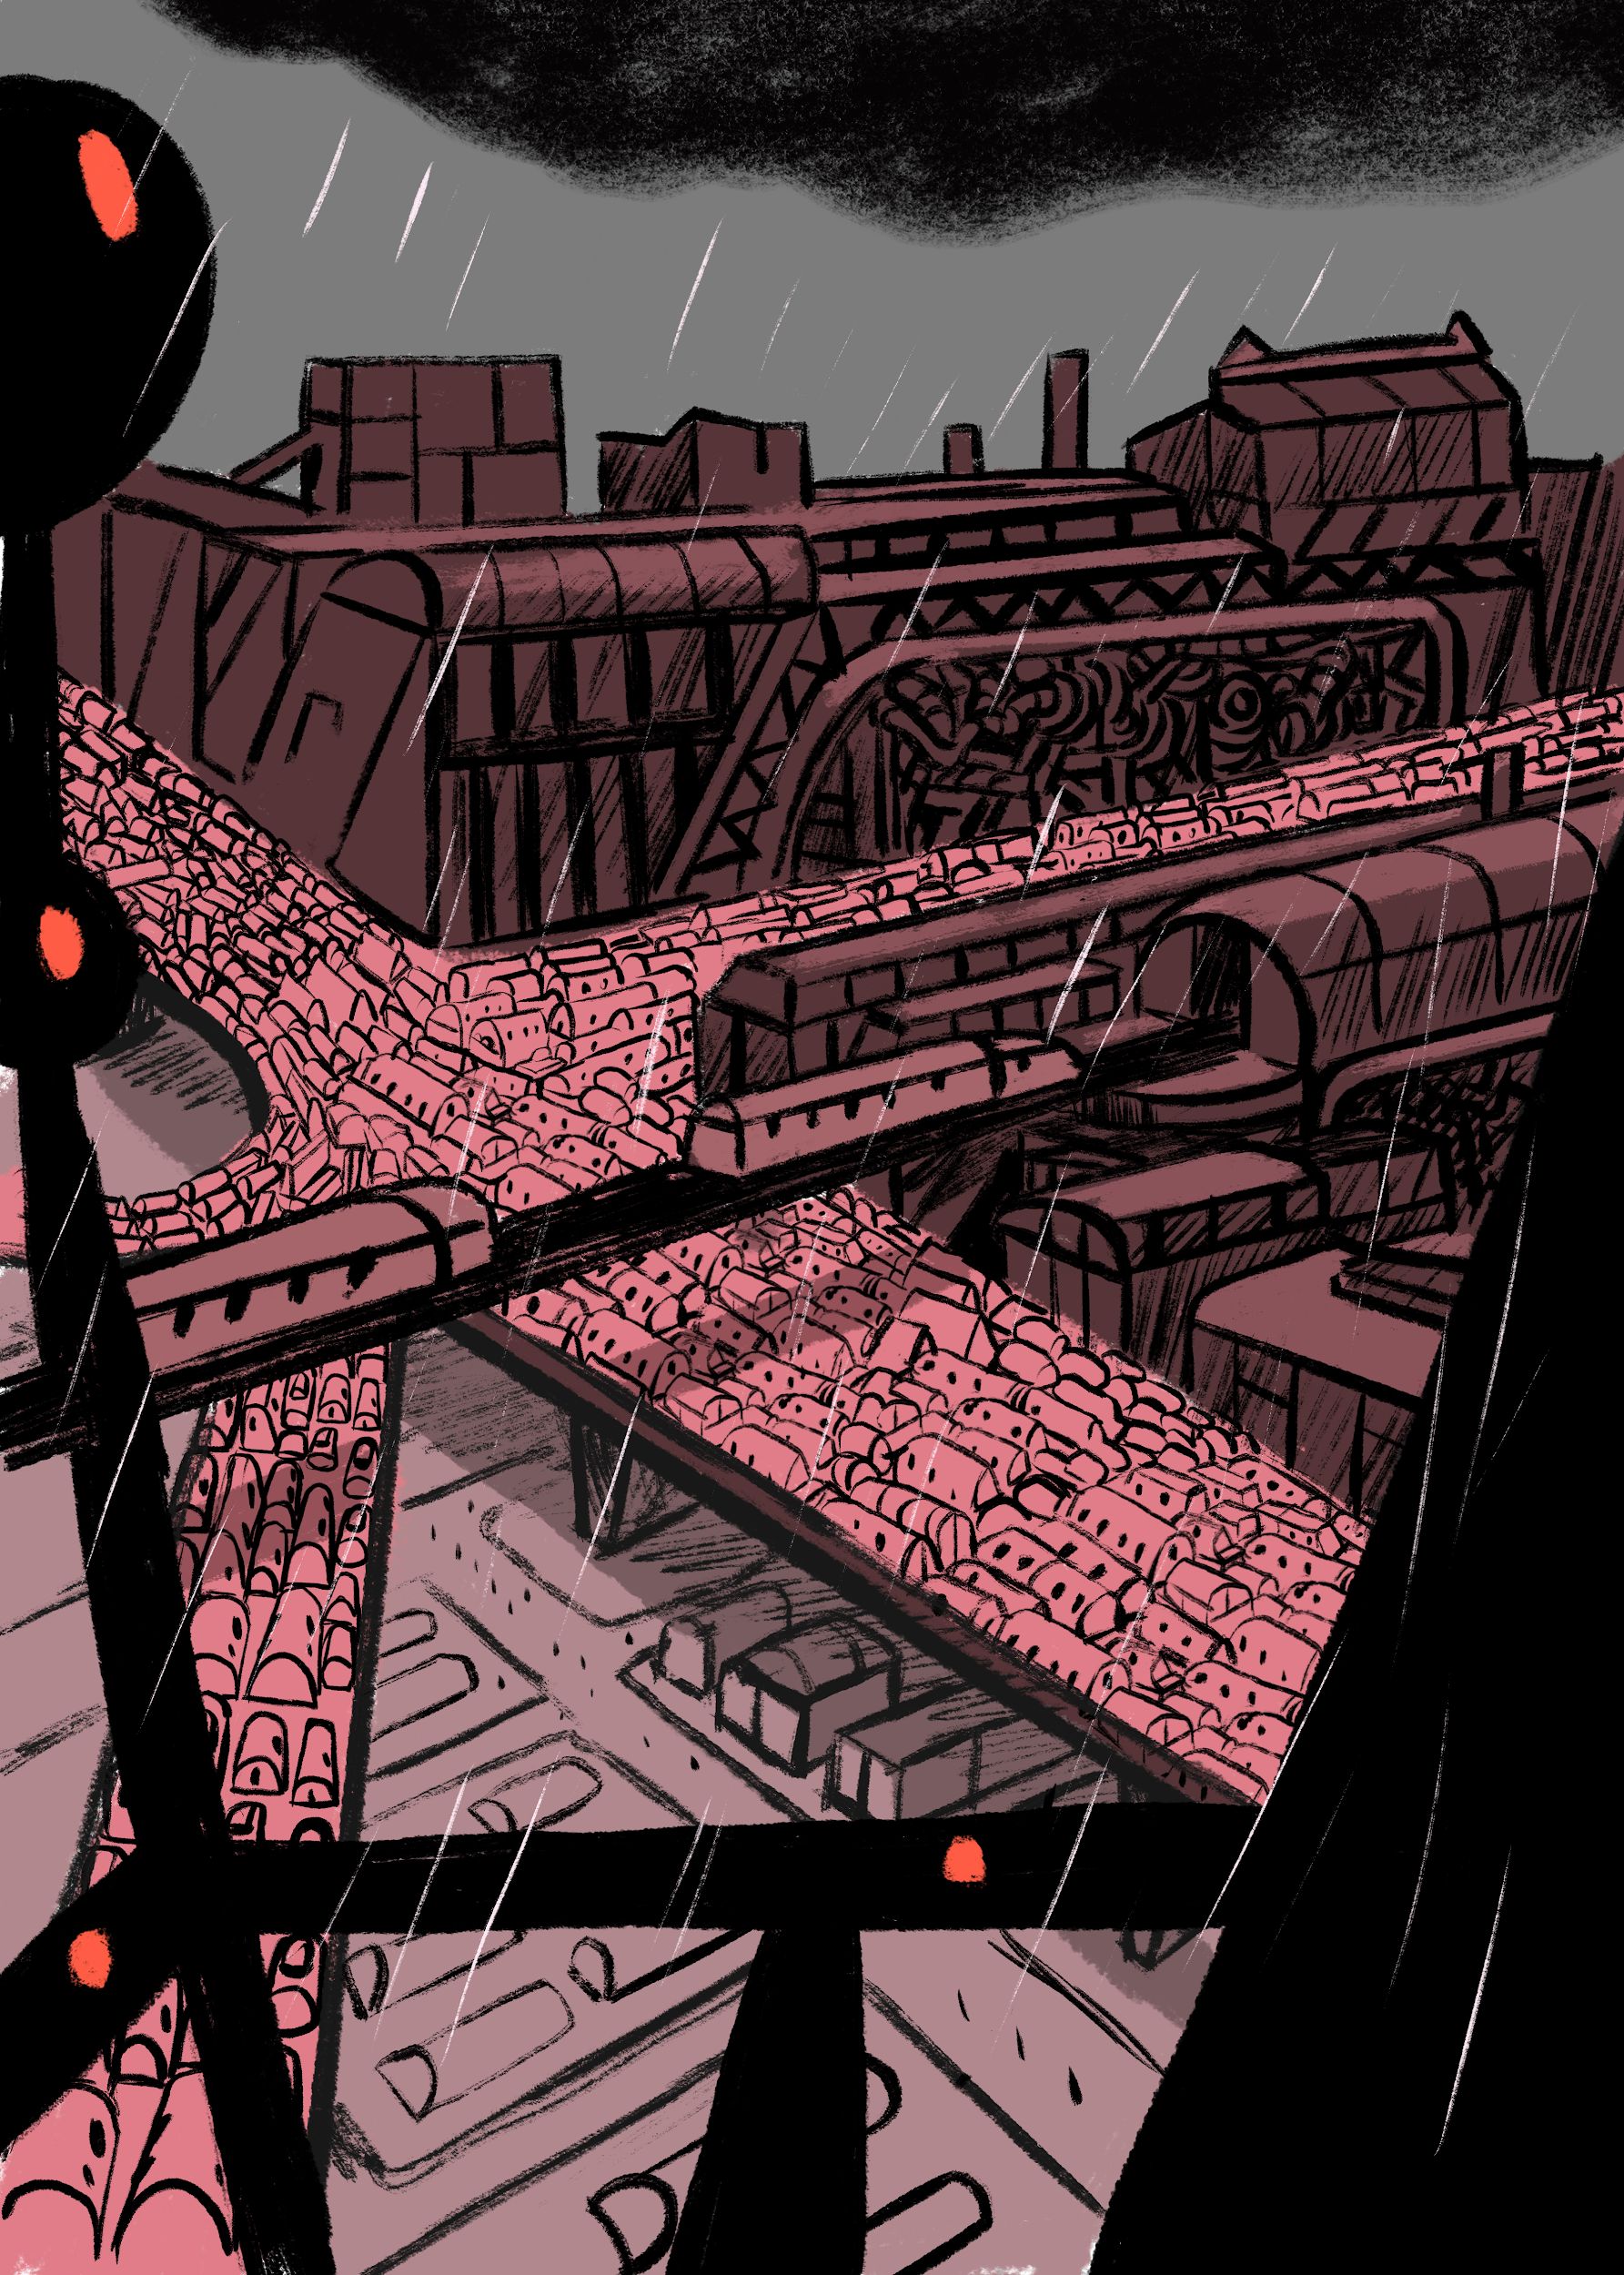
Luckily that blackout one got solved properly and quickly. Otherwise the whole operation would have been in danger. And the destiny of Lavonia sealed.
Next on the list of tasks is the jammed, packed unsafe and heavily polluting traffic of Lavonia. You are being told that even a short trip can take hours.
The traffic is also causing a lot of harmful air pollution as almost everyone is using their vehicles alone and public transportation on the planet is non-existent.
You are being tasked to give them some examples how the lavonians should re-organize their traffic and to make it more fluent. So first it’s good to have some examples how traffic is on planet earth.

Slide 28
ASSIGNMENT 7:
Read through the traffic section in your G.A.S.P. and answer the following questions for the lavonians.
How is the traffic close to your location?
What different kinds of vehicles are there to be seen in traffic close to your location?
Conduct a traffic count near your location.
Conduct a traffic count near your location using the camera of the Kitsat satellite.
Compare the data from both of these traffic censuses.
Which one is more reliable?
Which one is easier to conduct?
What could be done to improve these two traffic census?
How could different satellites be utilized in traffic monitoring?
How would you rationalize and make the traffic close to your school more environmentally friendly and fluid?

Slide 29
You write a sturdy and brief report spiced up with some neat developing ideas and suggestions to the lavonians regarding their problems with their traffic. Your terminal bleeps and you have received a weird looking emoji and a piece of the earth-like planet’s name and coordinates attached to it. The emoji looks really weird but it seems that it’s a lavonian version of a smiling emoji.
After the emoji the lavonians report that they have taken all of your ideas into consideration and a plan to make the planet’s traffic better is already in motion. But that emoji still bothers you.

Slide 30
The lavonians are again quick to react. They made the changes you suggested over a few days of time and the situation regarding traffic has improved.
But there is a new message on your terminal and after the alterations the traffic system is more fluid and environment friendly but there has been a steep rise on accidents and a large number of close calls regarding traffic and it’s safety.
Lavonians are asking for a few examples on how traffic safety is handled on Earth and how to improve it.

Slide 31
ASSIGNMENT 8:
The plan is to give the lavonians some examples of how to handle the safety of traffic by searching for a risky places near your own location and to explain how to make the risky place safer for everyone. Including different vehicles, pedestrians and cyclists and public transportation alike.
Divide into two groups. Other groups stays with the Kitsat ground station and computer. And the other group takes the Kitsat satellite outside.
The group going outside has to map out traffic’s dangerous or unsafe places near your location. Remember to try to place the satellite somewhere high up if possible.
The group inside takes a photo of the place by commanding the satellite’s camera. You can also try to take a panoramic shot of the place that you have found out.
Make sure to find out at least three places.
After the mapping out come up with solutions that could make the mapped out places safer in terms of traffic.
How space satellites could be utilized to make traffic on Earth safer?

Slide 32
You send the photos and your ideas of making these particular places safer for traffic to the lavonians. They are happy with your concrete examples and are going to make some big changes in their traffic system.
After a few days the lavonians report back to you. The changes have been made and things are looking good. There have already been two days without a single traffic accident or a close call situation. Your suggestions and examples paved the way to a lot more safer traffic on Lavonia. Great job!

Slide 33
Life at Lavonia seems to be settling for the better. The climate is much better, the extreme weather conditions are over and the traffic is flowing and almost free of pollution.
The do-to list on your terminal is clear and there has been a long time since the lavonians have requested any form of help from O.S.T.R.I.C.H.
But you check out the new planets and see that two piece of the coordinate and the name is still missing.

Slide 34
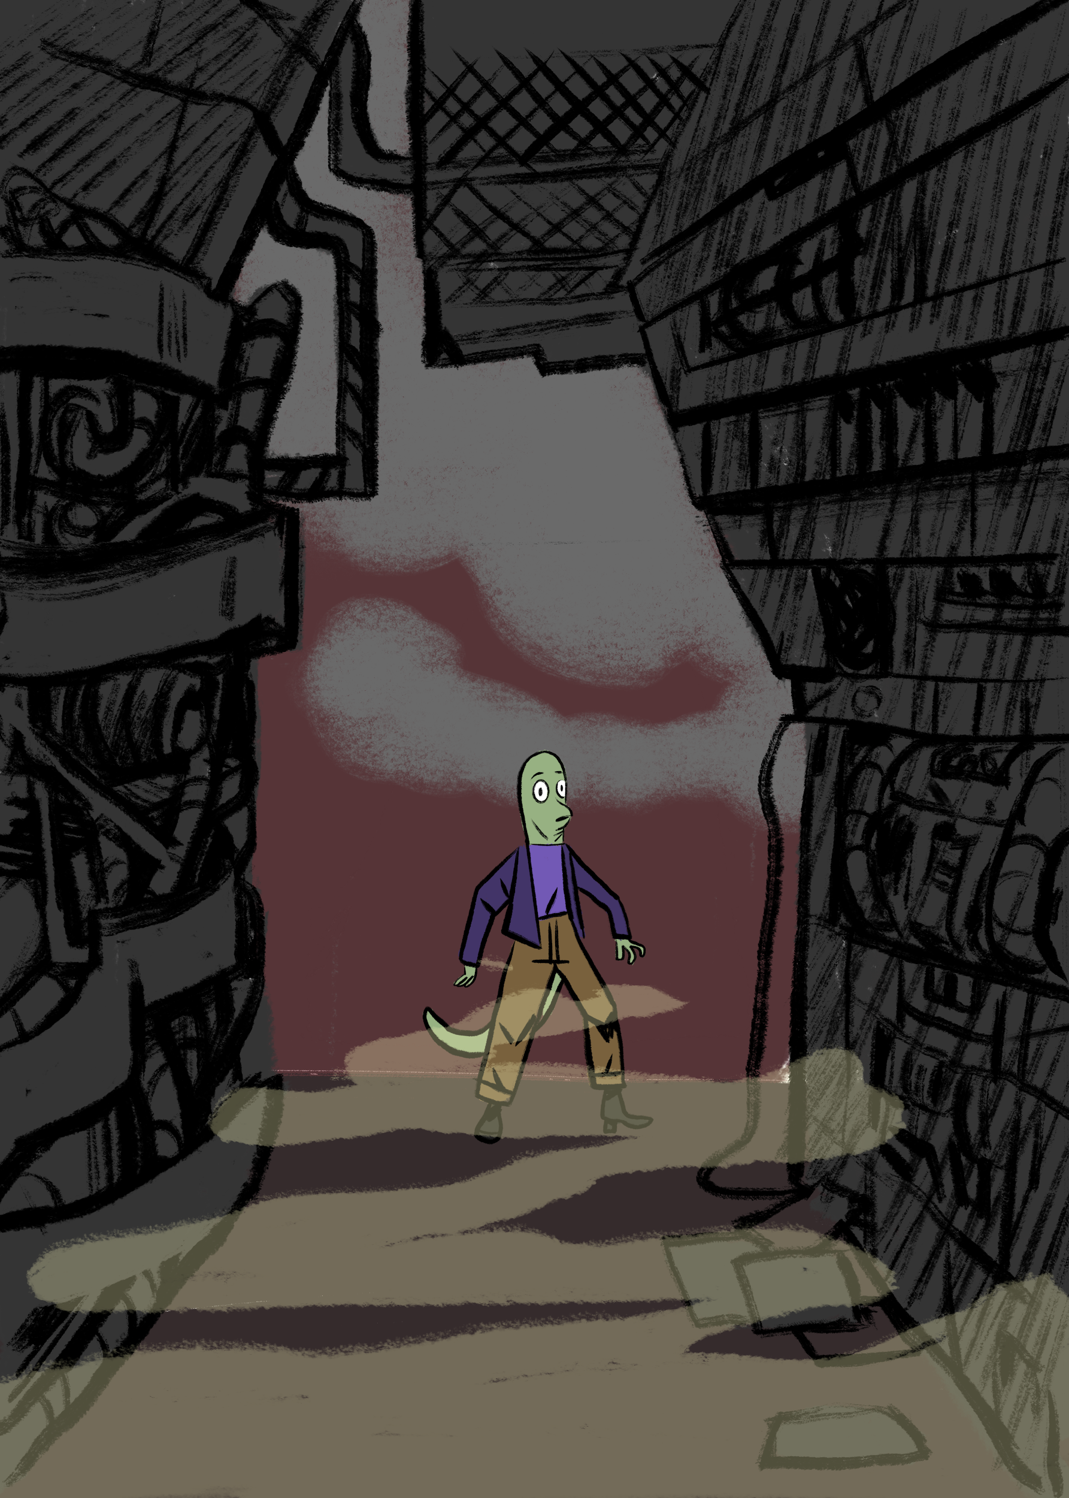
You flinch as your terminal bleeps. What?! They still need help. So two more assignments to go. But a promise is a promise. You open the message and read it through.
The lavonians are concerned about the amount of unsafe, unpleasant and scary places around the planet. They would like to know if there are such places on Earth and what to do with them.
You write them back and promise to help. An example would work out the best. So you decide to go out and look for a place that feels unpleasant and could also be unsafe. And try to figure out how to change these places.

Slide 35
ASSIGNMENT 9:
- Divide into two groups. Let’s call the groups X and Z. Group X stays put as the group Z goes to look for an unpleasant, scary or unsafe place near your locations with the Kitsat satellite with them.
- Group X stays and follows group Z through the data the Kitsat is sending. Once group Z has found a place group X activates the camera of the satellite and tries to find the other group interpreting the data and the photo.
- Once the groups have found each other they have to explain what makes the place scary, unsafe or unpleasant. After that they have to come up with a solution to make the place in which they are safer, more pleasant or less scary.
- Now it’s time to change the roles of the two groups
- Try to find at least four different places to give the lavonians concrete and straightforward examples.

Slide 36
You sit back at your terminal and report back to the lavonians. They thank you and promise to reply quickly.
Time goes on and it’s already been days since you send the report to the lavonians.
All of a sudden your terminal gives you the familiar bleep. They’ve replied!

Slide 37
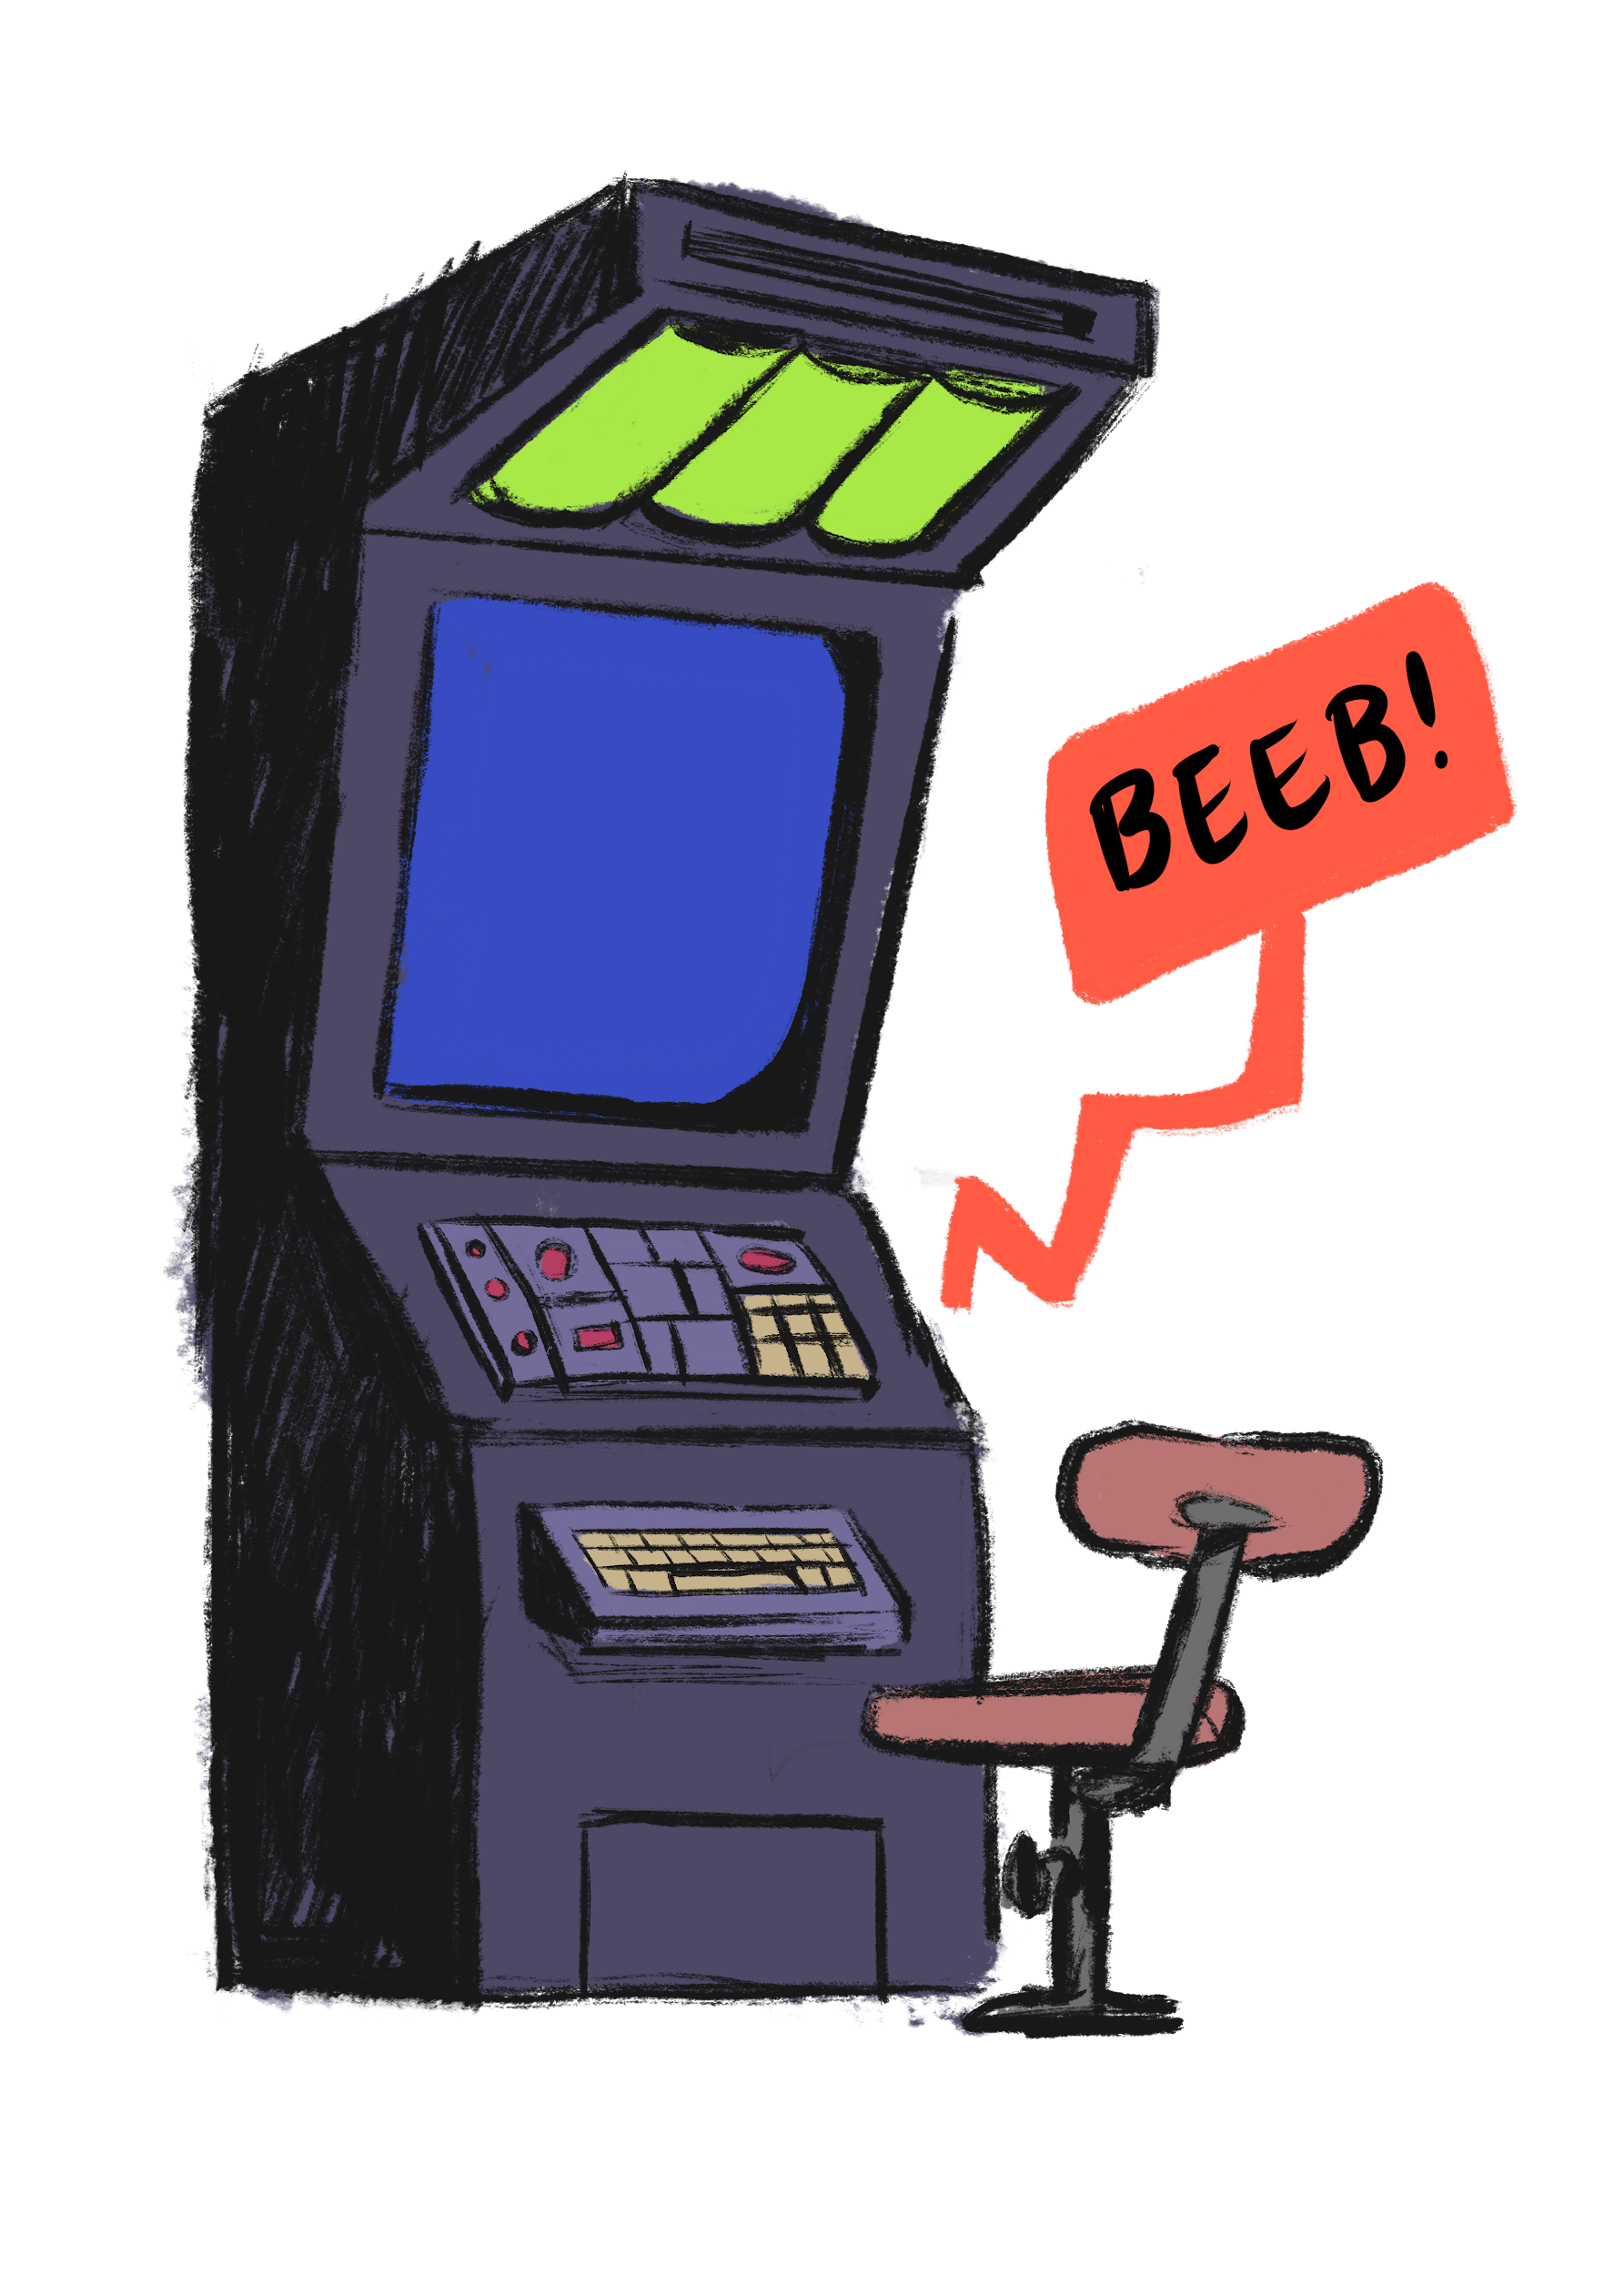
Once again your examples proved to be a decisive factor in making Lavonia a safer place for everyone.
Your terminal bleeps again and like a robot you are ready to help the lavonians. But now you are in for a surprise.
They don’t need any of your help! Attached to a long, glorifying and complimenting message you find two missing pieces of the planets name and coordinates. What a pleasant surprise.
Now the Earth has a back up plan if it ever falls into the same state as Lavonia. But how that would be even possible when there is such talent and know how focused on the teams that helped Lavonia and the lavonian out of the sticky situation they were in.
As the mission is over you are checking out the badges the directors of O.S.T.R.I.C.H. have granted you. Your terminal bleeps! What is it now!? The directors have messaged you. The messages starts by: “We are in need of immediate assistance…”

